Slide 1
Langchain
ChatOpenAI
GPT
APP
Input
Large Language
Model
GEMINI
ChatOllama
API
ChatGoogle
GenerativeAI
LLAMA
Output
MISTRAL

Slide 2
Web APP
Server
DB
Langchain
Large Language
Model
API

Slide 3

LLM
Large
Language
Model

Slide 4
Prompt
Input
GPT
Large Language
Model
GEMINI
What is Machine Learning
Output
LLAMA
Questions
MISTRAL
Marketing Campaigns
Summarising Text
Images
Videos
Multi Modal
Assistance

Slide 5
Streamlit

Slide 6
PromptTemplate

Slide 7
Chains
|
prompt
LLM

Slide 8
Simple Sequential Chain
Chain 1
Chain 2
|
|
|
|
INPUT
OUTPUT
OUTPUT
prompt
LLM
Parser
prompt
LLM
Parser

Slide 9
Sequential Chain
Chain 1
Chain 2
|
|
|
|
INPUT
OUTPUT
OUTPUT 1
prompt
LLM
Parser
prompt
LLM
Parser
INPUT 2
OUTPUT 2

Slide 10
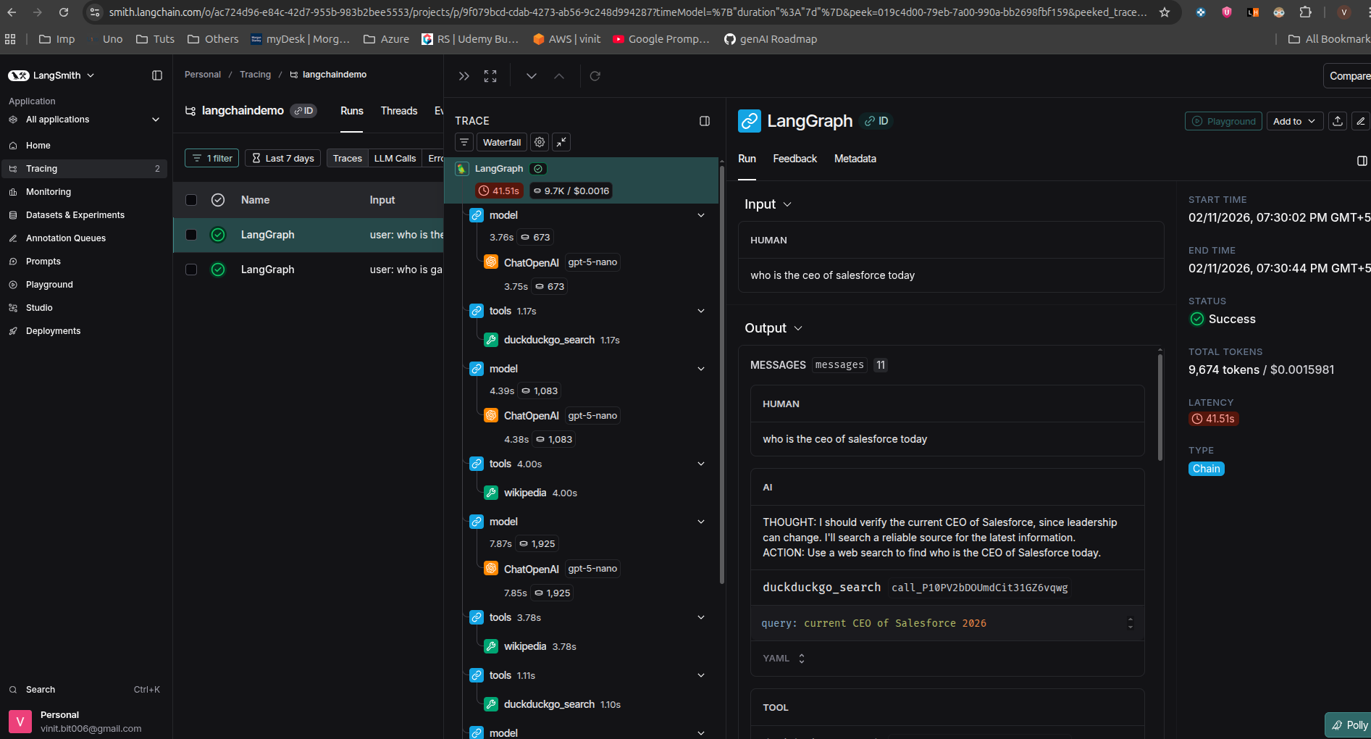

Slide 11
Chat History

Slide 12
Using Vector Database
[-0.1848554 -0.17605719
0.18991971 0.4797751
0.04560479 0.00489019
0.0982461 -0.07267588]
Vector
Store
Data Chunks
Query
Embedding
Model
[-0.1823554 -0.17605234]
Matching Data
Matching Data
Chroma
FAISS
PineCone
Lance
Document

Slide 13
RAG
Retrieval Augmented Generation
Prompt
Prompt
+
+
Outdated Data
Latest Data
Data
Relevant
Data
Our Own Data
LLM
LLM

Slide 14
RAG Process
[-0.1848554 -0.17605719
0.18991971 0.4797751
0.04560479 0.00489019
0.0982461 -0.07267588]
Vector
Store
Data
Prompt
Embedding
Model
[-0.1823554 -0.17605234]
Relevant Data
Prompt
+
Relevant
Data
Response
Document
LLM

Slide 15
Other LLMs
Google Gemini
Open Source
Llama
Gemma
Mistral
3.1
8B
2B
7B
2
7B
3B

Slide 16
7B
13B
33B
8GB
16GB
32GB

Slide 17
Deploy
Update the code
requirements.txt
Push to github
Deploy using StreamLit Cloud

Slide 18
Agent
Tools
Reasoning
Prompt
Action
LLM
Input
Observe
User
Response

Slide 19
Agent
Reasoning
Wikipedia
Action
Prompt
Search
Task
Wikipedia
LLM
Tools
Observe
User
Response

Slide 20
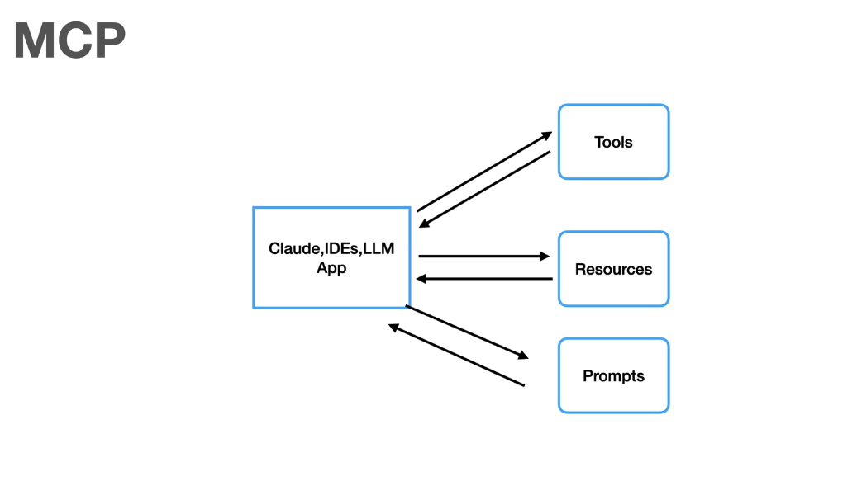
Why MCP
Duplication of tools, resources and prompts per host or agents.

Slide 21
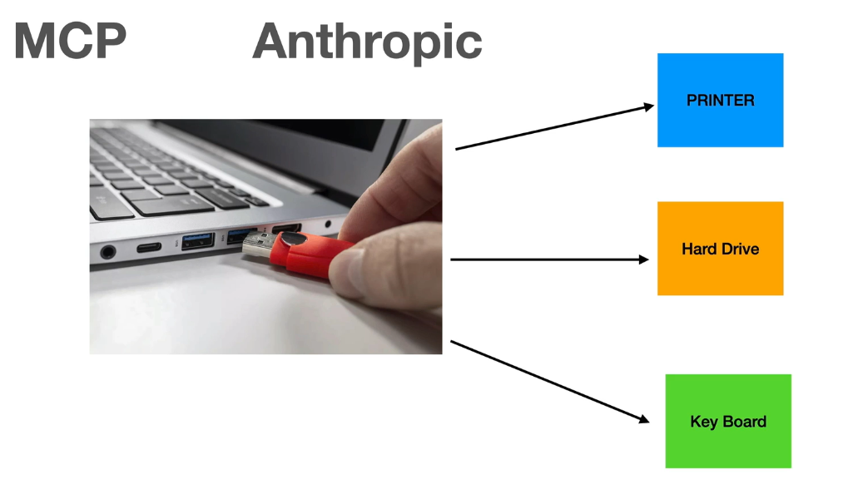
Anthropic introduced MCP

Slide 22
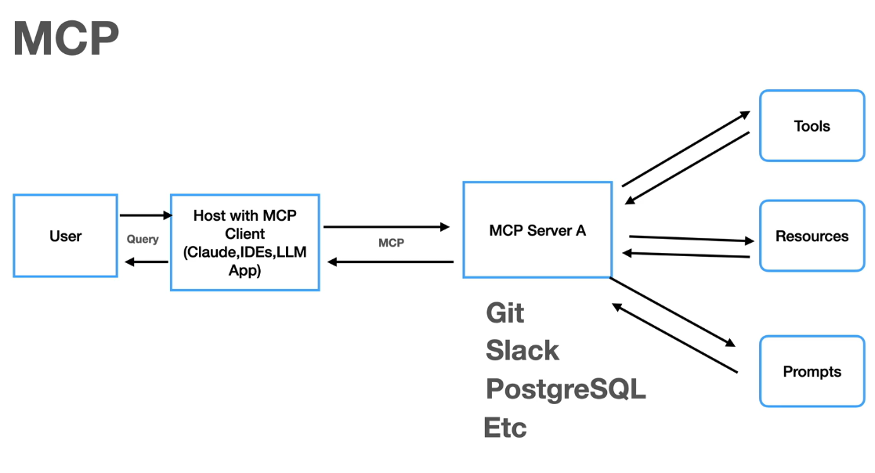

Slide 23
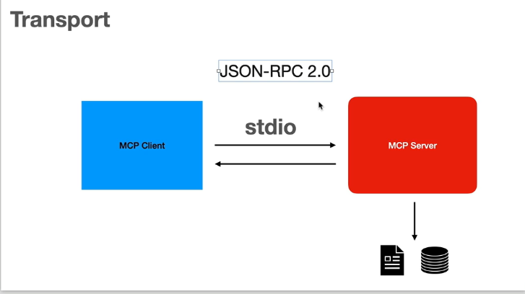

Slide 24
